Slide 1

Notes:
Thank you all for being here today! ASHRM’s board and staff are unable to join us because they are currently all at ASHRM Academy in New Orleans. I was asked to deliver this presentation on their behalf to help make sure that you are all aware of the resources that ASHRM has created to help you be more successful in your risk management career.

Slide 2



About ASHRM
Founded in 1980
36 affiliated chapters
Members from a variety of healthcare settings in U.S.
Notes:
The American Society for Healthcare Risk Management was founded in 1980 to provide support, information and collaboration for professionals in this field.
ASHRM is a Professional Membership Group of the American Hospital Association, with more than 6,000 individual members and 36 independent chapters. Its membership has grown to include not just risk managers but also patient safety and quality officers, insurers, lawyers, consultants and more.

Slide 3
Mission
Vision
To advance patient safety, reduce uncertainty, and maximize value through management of risk across the health care enterprise.
ASHRM is the leader in advancing safe and trusted health care through enterprise risk management.
Notes:
ASHRM works daily with its members, chapters, the AHA, and industry partners to realize its mission: to advance patient safety, reduce uncertainty, and maximize value through management of risk across the healthcare enterprise.
Providing healthcare in the United States requires that organizations and individuals be informed, prepared, and also nimble. Regardless of our role, each of us certainly feels challenged to improve our organizations and the healthcare system. When you challenge your organization to innovate, and to improve, then YOU are an example of ASHRM’s vision. This is true leadership and we know that each of our members are exhibiting that every day. Like you, ASHRM is working to show leadership by assisting its members, chapters and collaborators to improve the practice of risk management.
ASHRM accomplishes it’s vision of maintaining its place as the leader in advancing safe and trusted healthcare by making these ideas the core of everything it does.

Slide 4

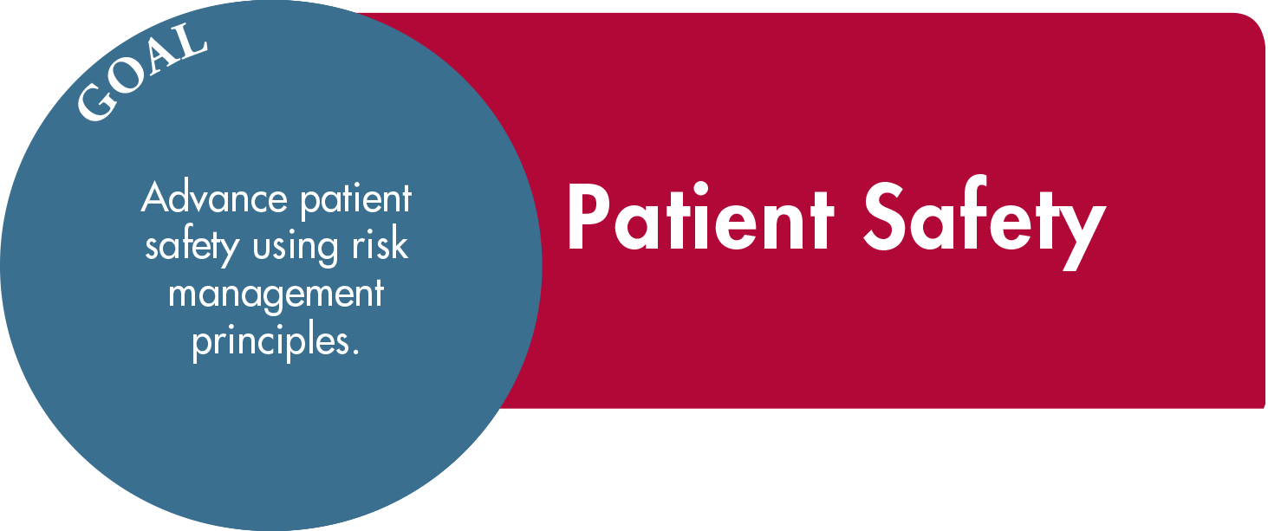
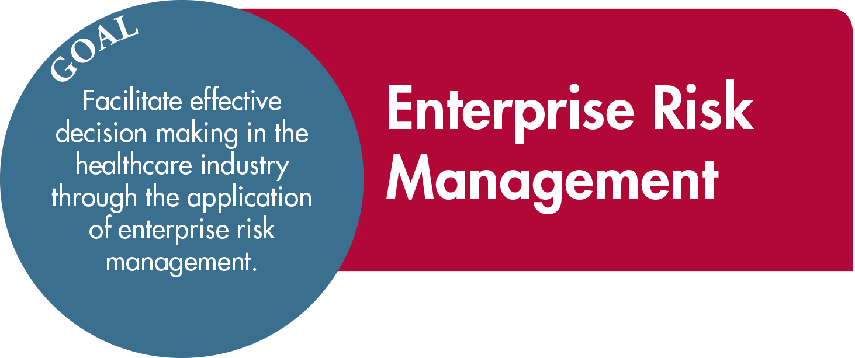
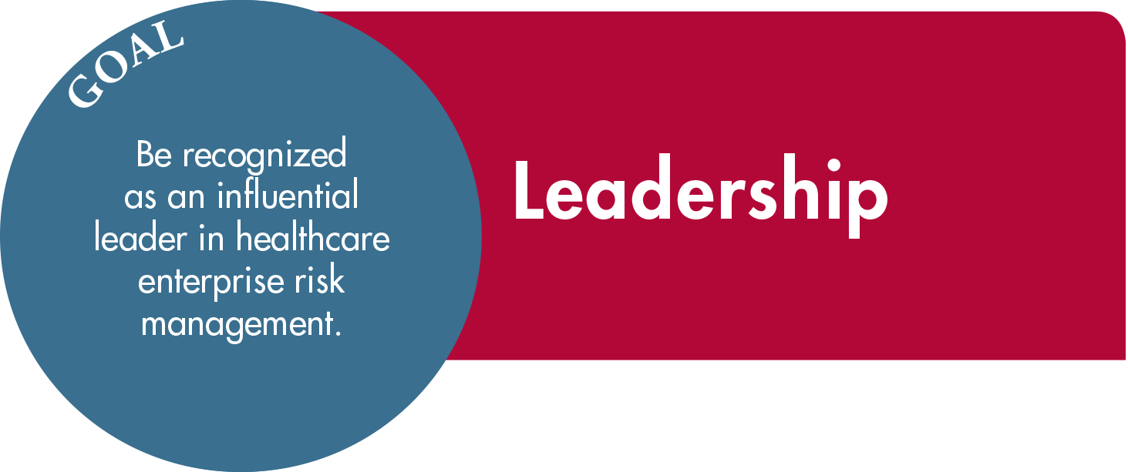
Strategic Plan
Notes:
To realize its mission and vision, ASHRM has created a strategic plan with four goal areas: Governance & Operations, Patient Safety, Enterprise Risk Management, and Leadership.
The first of these four goals, ensuring effective governance and operational infrastructure, is largely internal- this is ASHRM’s commitment to being a good steward of member dollars and interests.
The remainder of this presentation will focus primarily on the three externally impactful goals: enterprise risk management, patient safety and leadership.

Slide 5
ASHRM’s Impact
What we do
How we do it
Promote safe and trusted healthcare practices
Advance the specialty and its professionals
Education
Professional Development
Resources & Tools
Networking Opportunities
Advocacy
Notes:
ASHRM provides not only the every day tools that you need to manage risk and improve patient safety, but also the means for you to excel in your career and for our membership to advance the entire profession.
This is accomplished through the development of programs, publications, and advocacy efforts that support the goals of the strategic plan.

Slide 6

Goal: Enterprise
Risk Management
Facilitate effective decision making in the healthcare industry through the application of enterprise risk management.
Notes:
ASHRM is dedicated to facilitating effective decision making in the healthcare industry through the application of enterprise risk management.
ERM promotes a comprehensive organizational framework for making decisions which maximize value by managing risk and uncertainty.
ERM implementation is becoming more commonplace in healthcare organizations. But, we still lag behind large organizations in other fields, such as financial management. Although many healthcare risk management professionals implement ERM strategies for new initiatives (particularly to manage clinical risk), they fail to advance ERM strategies on an organization-wide basis, and thus miss tremendous opportunity to increase or create value. Recognizing the elements necessary for ERM program development and embedding those elements in the enterprise is central to program success and sustainability.
ASHRM has created a catalog of resources meant to help bolster ERM efforts, and address risk within eight crucial domains: operational, clinical, legal, strategic, hazards, technology, finances, and human capital.

Slide 7
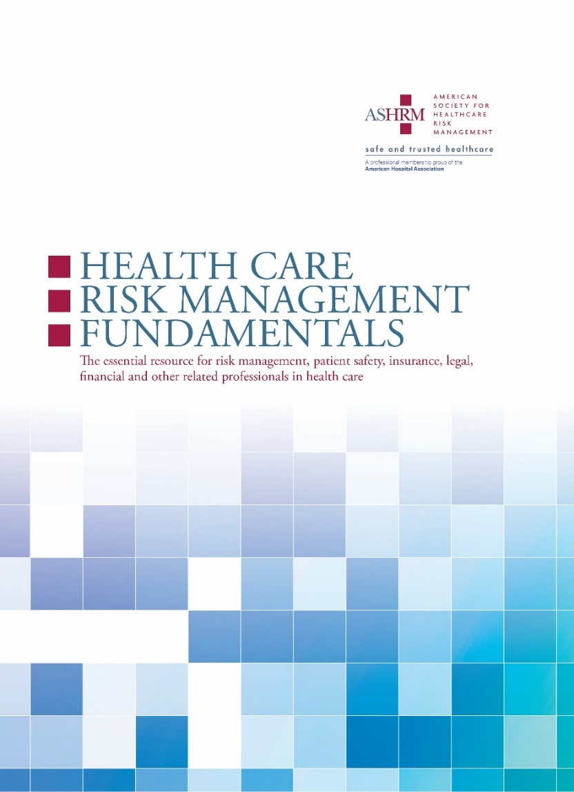
Health Care Risk Management Fundamentals
NEW!
The basics, in detail.
Enterprise Risk Management explained by domain
Guidance for both new and experienced risk managers
Notes:
ASHRM is excited to showcase a new book this year- Health Care Risk Management Fundamentals: The essential resource for risk management in health care. This book is intended to illuminate all the domains of ERM and allow you to understand the risks associated with the moving parts of an entire organization.
The Fundamentals book is part of ASHRM’s continuous effort to address the needs of our diverse membership. Risk managers are not typically content experts in the functions of ALL departments that may encounter risk throughout an organization. But, in order to be a resource to a variety of departments, you have to have a certain level of familiarity with the issues that they may experience.
It is useful for both newcomers to the field, who need a solid foundation of knowledge to build upon, and veterans, who may need to gain a base level of understanding in areas of the field with which they are less familiar. We hope that the Fundamentals will become the backbone of your risk management library, giving you a starting point to address any number of issues across the enterprise.

Slide 8


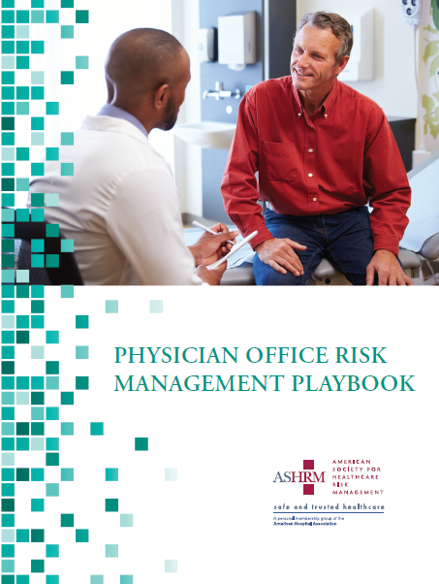
NEW Playbooks
Notes:
ASHRM has structured our publications, courses, and other resources to provide both breadth and depth within our educational catalog. Our successful Playbook series is a great example of our commitment to give you the materials you need to dive in to every aspect of risk management and many of the playbooks focus on the ERM domains that ASHRM has identified.
ASHRM’s Physician Office, Risk Financing, and Obstetrical Risk Management Playbooks have all been released in the last two years. And, another new resource will be available soon: the Claims & Litigation Playbook comes out this summer!

Slide 9
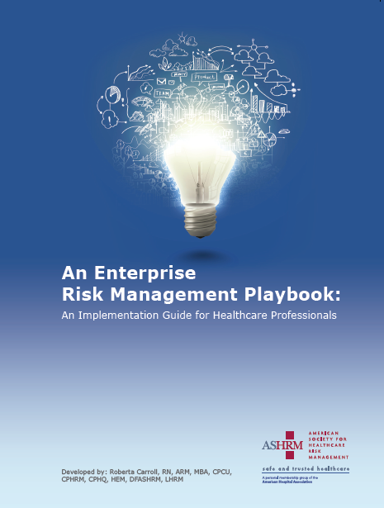
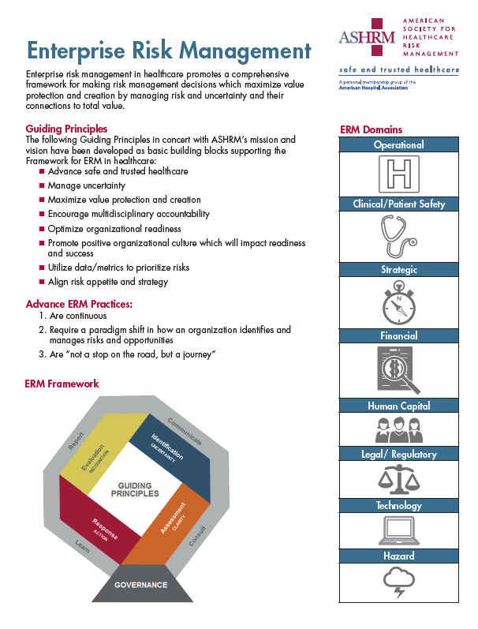
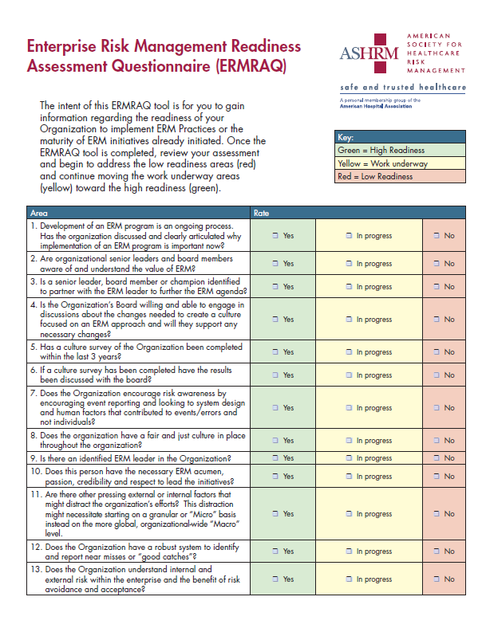
ERM Resources
ERM Playbook
Quick Reference Guide
Readiness Assessment Questionnaire
Resource for Boards and Trustees
Notes:
ASHRM’s ERM Playbook has been an invaluable addition to our resource catalog and the ERM toolkit now includes a quick reference that outlines the framework for ERM, including guiding principles and the domains. We also offer an ERM Readiness Assessment Questionnaire, which will help you evaluate the readiness of your organization to implement ERM practices.
ASHRM has also produced a guide for hospital Boards & trustees to help them understand the value of ERM, the role the risk manager plays, and where their hospital is on the journey. This has been delivered electronically to trustees in AHA-member hospitals and health systems. Please consider using this tool and sharing it with others in your organization to help executive leaders understand how you can be an important resource for them and to make sure that you have a seat at the table BEFORE a crisis occurs.

Slide 10
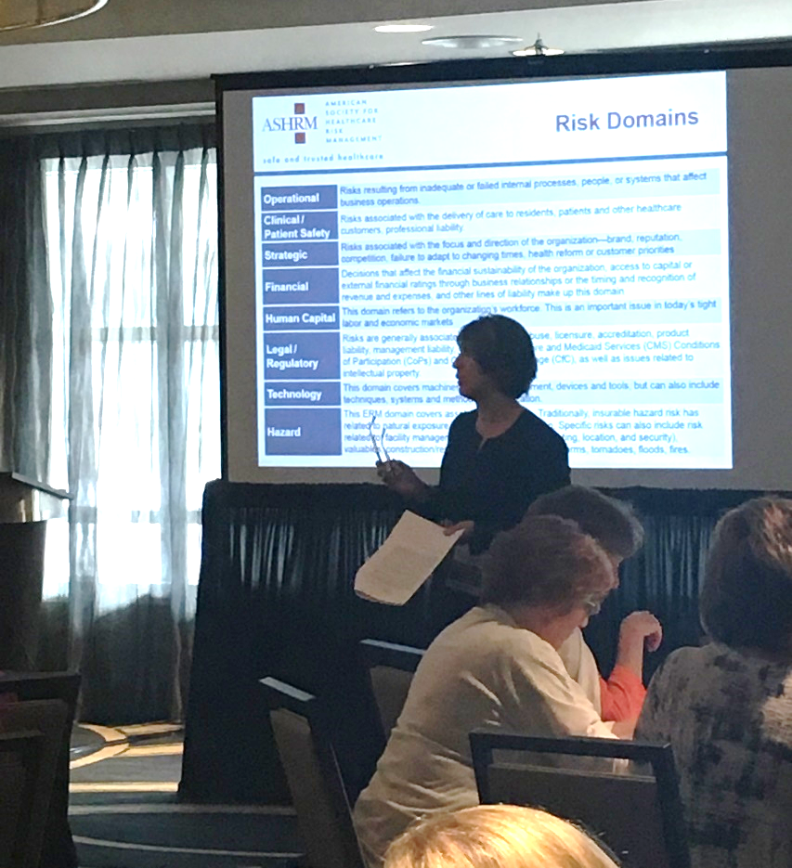


ERM Certificate Program
Nine online modules,
One in-person course
www.ASHRM.org/ERM
Notes:
And, for those that are ready to put theory to practice, ASHRM offers the ERM Certificate Program: an insightful road map that prepares healthcare risk management professionals to balance risks with rewards.
This unique blended learning program provides a three-prong approach to ERM: concepts, strategies, and application. The program begins online, where participants work both independently and collaboratively to explore ERM concepts and strategies. Next, participants and ERM faculty meet in person to engage in discussion, review case studies and learn about practical application. Lastly, the program concludes with a follow up online component to allow for ongoing communication and collaboration as participants put theory to practice back home.
There are two sessions of this program each year in the spring and fall. Visit the ASHRM website to learn more!

Slide 11

Goal: Patient Safety
Advance patient safety through a value-driven approach.
Notes:
ASHRM’s next goal is to advance patient safety through a value-driven approach. We accomplish this, in part, by leading and supporting our members’ ability to implement patient safety practices and by recognizing excellence in patient safety.

Slide 12
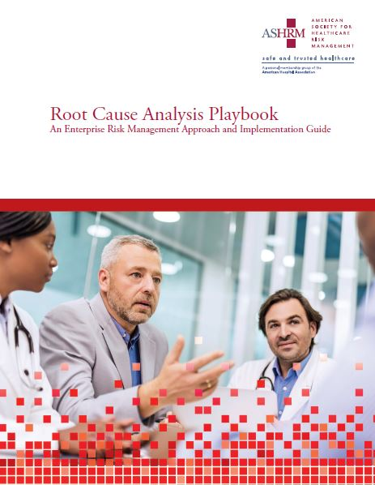
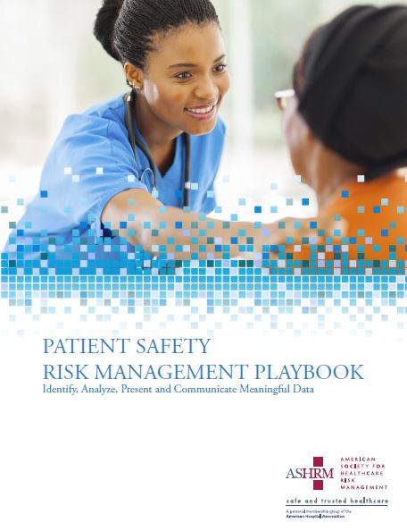
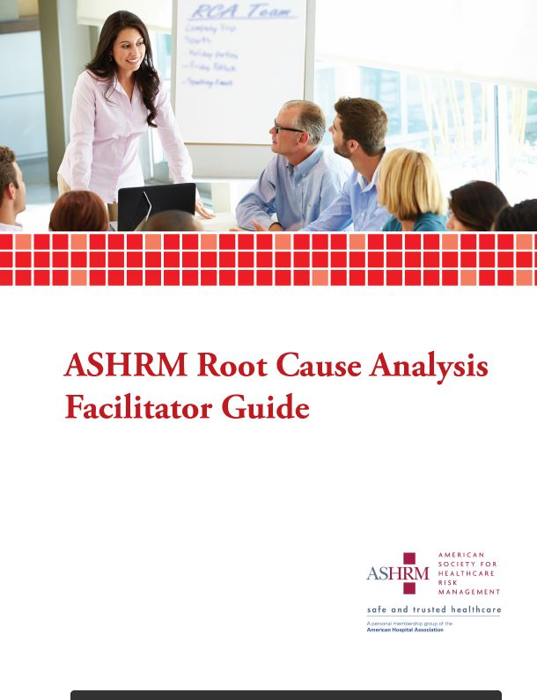
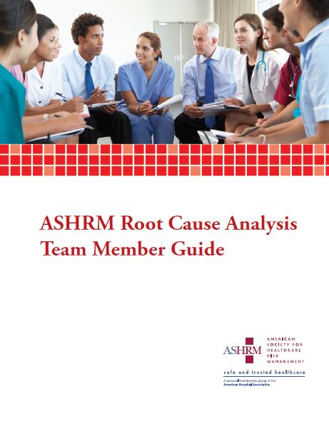
Patient Safety &
RCA Resources
Notes:
The Patient Safety Playbook will help you utilize data and metrics to support patient safety and risk reduction programs and initiatives.
The Root Cause Analysis Playbook provides guidance on methods for standardizing the RCA process to assist health care organizations in achieving sustainable results and preventing recurrence of serious safety events.
Finally, the RCA Team Member Guide and Facilitator Guide build upon the framework provided in the RCA Playbook. These workbooks are intended to help risk managers extend their reach during the RCA process and to assist participants to be effective team members.

Slide 13

2018 ASHRM
Patient Safety Award
Recognizing organizational excellence and celebrating the efforts of risk management professionals.
Application deadline: June 1
www.ASHRM.org/PatientSafetyAward
Notes:
If your facility is doing outstanding work in the area of patient safety, please consider nominating your team for the ASHRM Patient Safety Award, which was established to recognize organizational excellence and celebrate the efforts of risk management professionals in promoting patient safety across the health care enterprise. The deadline is coming up on June 1 so, if you are interested in submitting a nomination, please take a look at the ASHRM website as soon as possible. The award will be announced at the ASHRM Annual Conference in October.

Slide 14

Goal: Leadership
Be recognized as an influential leader in healthcare enterprise risk management.
Notes:
ASHRM’s next goal is Leadership. To be an influential leader in healthcare enterprise risk management, ASHRM offers a variety of services that are meant to advance the field and support the professional development of our members.

Slide 15
Advancing the Specialty
Regulation/Accreditation
Health IT/EHR
Healthcare Reform Implementation
Medical Professional Liability Reform
PPACA
CMS Requirements including:
    Healthcare Acquired Conditions
    Health Information Technology—Meaningful Use
    Hospital Inpatient Prospective
    Payment System Rule
    Value Based Purchasing
    Application of EMTALA to Inpatients
The Joint Commission Standards
and National Patient Safety Goals
Notes:
ASHRM regularly concerns itself with advocacy issues which affect the risk management profession, such as patient safety, HIPAA, and disaster preparedness.
In 2017, the ASHRM Advocacy Task Force spent a day working on your behalf to ensure that the AHA’s Advocacy Team in Washington has a good grasp of the Risk Management perspective to help inform its work. Through our partnership with AHA and its involvement with the Department of Health and Human Services, Joint Commission and state agencies, ASHRM ensures that your voice is heard.
In addition to the items on this slide, ASHRM attends industry events, works with the media, and collaborates with other organizations to make certain that risk management considerations are front and center whenever necessary.

Slide 16
HRM Week
Celebrate Healthcare Risk Management!
JUNE 18-22, 2018
A national campaign to promote awareness of risk management, providing communication tools to help you to promote the value of risk management to your organization, employer, and co-workers.
www.ASHRM.org/HRMweek
Notes:
As part of our effort to increase awareness of the Healthcare Risk Management field, ASHRM is proud to sponsor Healthcare Risk Management week. HRM week is a national campaign to promote awareness of risk management, held during the third week of June each year. Please celebrate and encourage your colleagues to take this moment and educate others about the importance of risk management in healthcare.
Visit www.ASHRM.org/HRMweek to find tools and resources to help you spread the word!

Slide 17

Notes:
The ASHRM annual conference is its signature event, featuring several keynotes, dozens of breakouts, and a Solution Center where you can go to connect to the vendors that will ensure your success. This year, the conference will be in Nashville on October 7th through the 10th.
If you have not been to ASHRM’s conference before, I highly recommend that you visit www.ASHRM.org/Annual to see what it’s all about. This is the risk management event of the year and you don’t want to miss out!
Conference registration opens in just a few weeks so please be on the lookout for more information about this event. Hotel rooms are first-come, first-serve so you’ll want to register early and be in easy walking distance. If you are not yet an ASHRM member, you can apply for membership as part of conference registration. Membership costs the same as the difference between member and nonmember registration- so, members effectively get ALL the benefits of membership PLUS the conference for the same price as nonmembers pay for JUST the conference.

Slide 18

ASHRM Academy
Certificate Programs:
  Healthcare Risk Management
  Enterprise Risk Management
  Patient Safety
  Risk Financing
CPHRM Prep Course
Save the Date: April 2019, Phoenix
Notes:
And, for those that are interested in a deeper dive than one can get from breakout sessions, ASHRM offers an opportunity for risk managers to gain in-depth training on several key topics. ASHRM Academy can further your professional development and elevate your resume by helping you obtain certificates in Healthcare Risk Management, Enterprise Risk Management, Patient Safety, and Risk Financing. This year’s Academy actually just wrapped up yesterday in New Orleans! More information about Academy 2019 in Phoenix will be released later this year. ASHRM’s CPHRM prep course is also held at this meeting every spring.

Slide 19
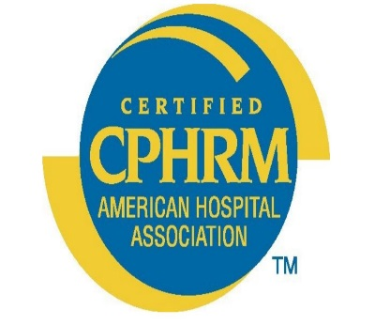
CPHRM Designation
Offered by AHA Certification Center
More than 2,500 certificants
ASHRM provides prep materials
Notes:
ASHRM’s leadership is demonstrated, in part, by the number of individuals who are certified and able to use the coveted Certified Professional in Healthcare Risk Management designation.
The American Hospital Association’s Certification arm offers the CPHRM designation for professionals in healthcare risk management to help them distinguish themselves within the profession. ASHRM is proud to provide materials to help test-takers prepare.
There are now over 2,500 certified professionals in healthcare risk management.

Slide 20
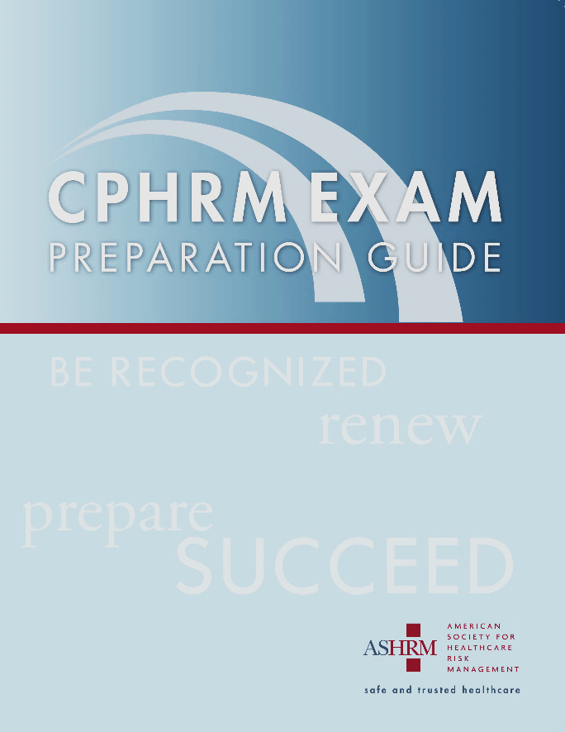
CPHRM Preparation
CPHRM Prep Course
Exam Prep Guide
CEU offerings
www.ASHRM.org/CPHRM
Notes:
If you are interested in obtaining your CPHRM designation, ASHRM is a one-stop shop for study materials. The CPHRM prep course is offered in two formats: live and on-demand. The live meeting is offered twice per year ─ in the spring and then again in fall as part of the annual meeting pre-conference activities.
ASHRM also has a comprehensive prep guide available to help you study and take practice tests. And, for those that obtain the CPHRM, all ASHRM’s educational activities offer continuing education units to maintain the designation prior to renewal.
Please keep in mind: the exam, all prep materials, and CE offerings are provided at a steep discount to ASHRM members. So, it is most cost effective to purchase a membership prior to going down the CPHRM path. With the discounted purchase of the exam alone, membership will already have paid for itself.

Slide 21

ASHRM University
CE tracking
CPHRM Prep Course
Monthly webinars
Notes:
ASHRM also holds 12 to 15 webinars each year, which are then permanently archived within ASHRM University, its online learning center. On ASHRM U, you can purchase and view these materials as well as track your continuing education units and print records to help you renew certifications. There are more than 85 presentations now available on this platform, including some of ASHRM’s more robust offerings like the CPHRM prep course.

Slide 22
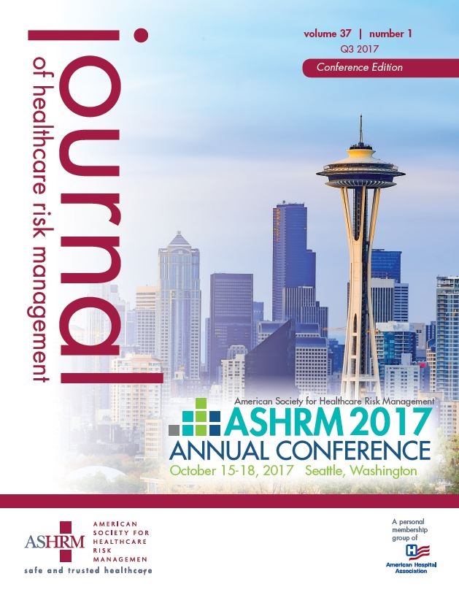
Journal of Healthcare Risk Management
New!
Get CE’s for reading journal articles
Notes:
ASHRM’s Journal of Healthcare Risk Management, published quarterly, focuses on insightful, peer-reviewed content that relates to patient safety, enterprise risk management, insurance, legal and other timely healthcare risk management issues. The award-winning Journal continues to evolve and ASHRM has recently begun offering continuing education credits for reading articles. To obtain credit, readers just visit ASHRM University and take a quick quiz for 1 credit per featured article.

Slide 23

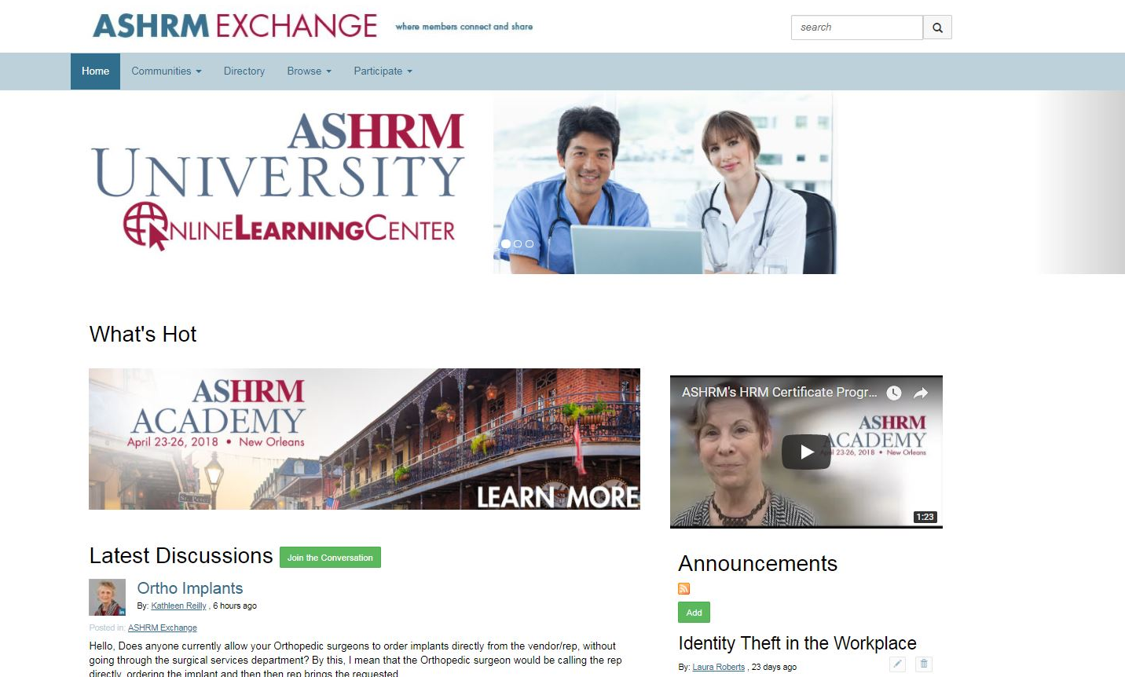

ASHRM Exchange
ASHRM Exchange
24/7 Access to Risk Management Advice
Discussion Boards
Resource Library
Networking Opportunities
Member Directory
Event Announcements
Emailed Digest
www.ASHRM.org/Exchange
Notes:
The ASHRM Exchange continues to be one of the most popular and valuable offerings that ASHRM provides to its members. This is because ASHRM’s best member benefit is the members themselves!
If you have access to ASHRM Exchange, you are never alone. The generosity and collegiality of the risk management community knows no bounds. Every day ASHRM members pose thoughtful questions and share helpful tools via this exclusive online discussion board. More than 10,000 conversations have occurred on Exchange and there are more than 500 tools, resources, and templates available in the library. If you are not taking advantage of this opportunity to learn from your peers every day, you are missing out!

Slide 24
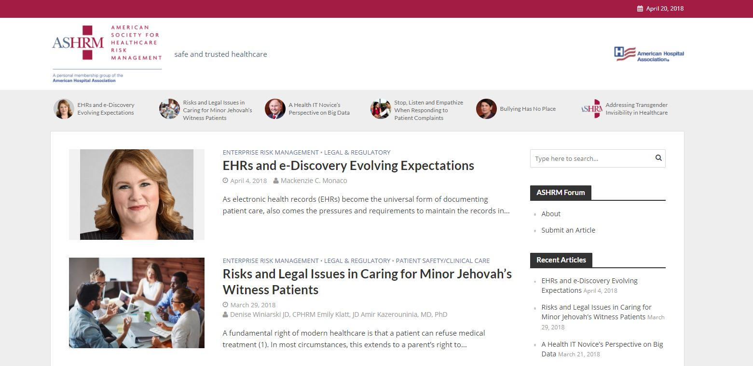
www.ASHRM.org/Forum
Notes:
ASHRM’s forum features regular articles from experts in Patient safety, Enterprise risk management, Health technology, Claims and litigation, and more. You can stay on top of the latest and greatest in the field of risk management by checking the Forum website or subscribing to ASHRM’s eNews using the signup button on our homepage.

Slide 25

Vendors Directory
www.ASHRM.org/VendorsDirectory
Notes:
ASHRM’s vendors directory provides a searchable database of risk management services and products. This guide will help you quickly find technology solutions, professional services, products that improve patient safety, and more.

Slide 26
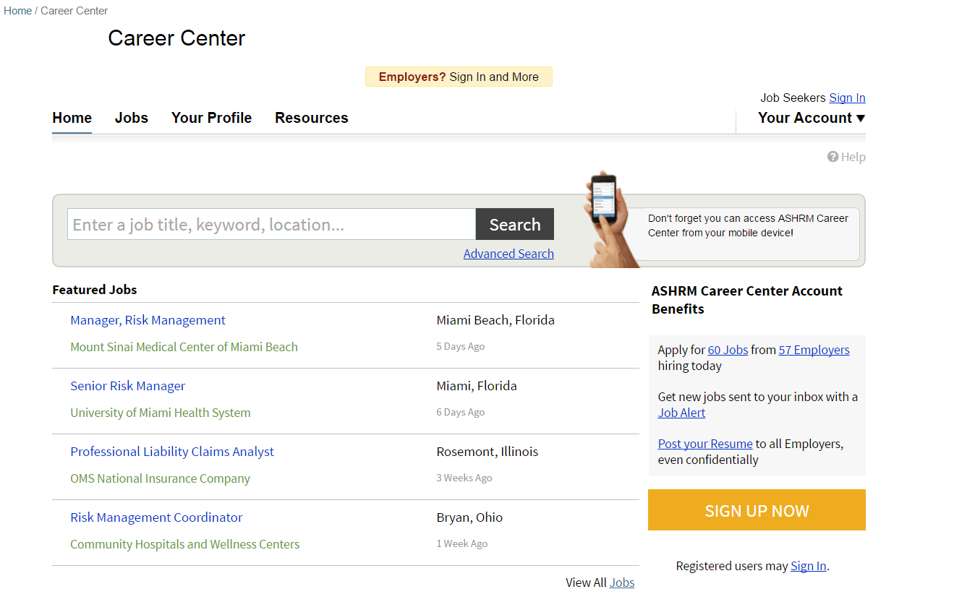
Career Center
Free Job Searching!
Upload your resume
Find career change resources
Post a job
www.ASHRM.org/Careers
Notes:
You can find or post a job, watch career advice videos, and download cover letter and résumé templates using ASHRM’s career center.
ASHRM is one of approximately 300 organizations that collectively make up the National Healthcare Career Network. This means that your job search keywords will also pull jobs from the career centers of the other participating healthcare organizations. So, instead of just seeing the nurse executive jobs that have been posted to ASHRM’s job board, you will also see nurse executive jobs that have been posted to OTHER participating job boards in the network.
The opposite is true for employers as well- when you post a job, you are posting to qualified job seekers all over the National Healthcare Career Network. Once again, ASHRM’s connection help propel to the result you’re looking for!

Slide 27




Connect with us!
www.ASHRM.org
Notes:
Finally, ASHRM demonstrates its leadership by maintaining a web presence that helps us stay connected, increase awareness, and provide support to healthcare colleagues around the world. If you have any questions about ASHRM’s resources or this presentation, I invite you to visit the website at www.ASHRM.org for more information or to follow ASHRM on social media for daily updates.
Thank you all for joining us here today. On behalf of ASHRM, I hope you have a wonderful conference!

